Slide 1
Heating , Ventilation and Air Conditioning system using Raspberry Pi and DHT 11
By- Agnik Saha( Y- 203)
Abhrajeet paul(Y-175)
Fuad Bin Zafar(Y-196)
Rahul Rudra(Y-192)
Aninda Mohanta(Y-201)
Anusree Saha(Y-200)

Slide 2
Aim
The project is the model of the small and large scale of
Building management automated system. The operation of
the project is to control four chambers simultaneously on
different temperatures taken directly from sensors and
showed on screen while providing sufficient cooling/heating.

Slide 3
Components
RASPBERRY PI 3 B+
DHT11 Temperature and humidity sensor
16*2 LCD display

Slide 4
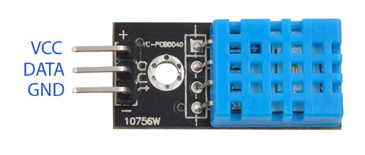
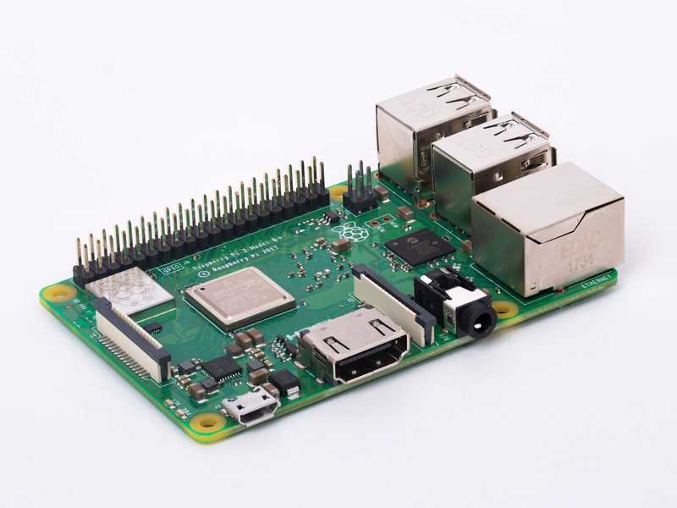
CONNECTING THE DHT11 TO THE RASPBERRY PI
There are two variants of the DHT11. One is a three pin PCB mounted module and the other is a four pin stand-alone module.

Slide 5
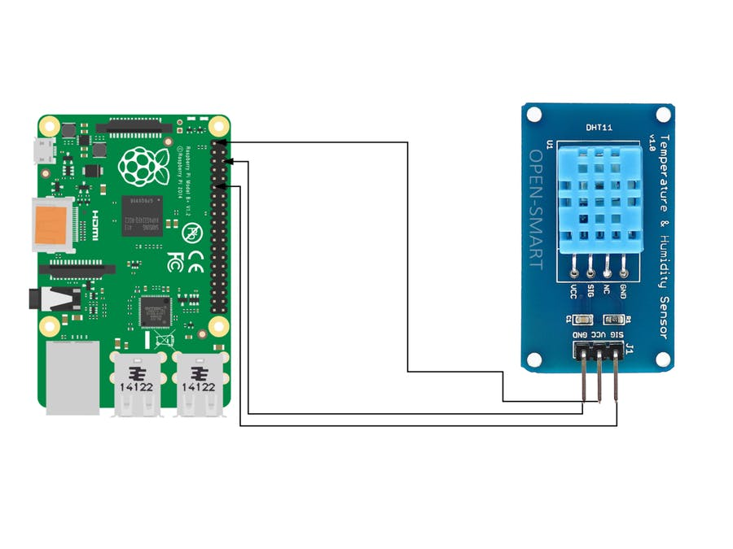
Circuit diagram

Slide 6
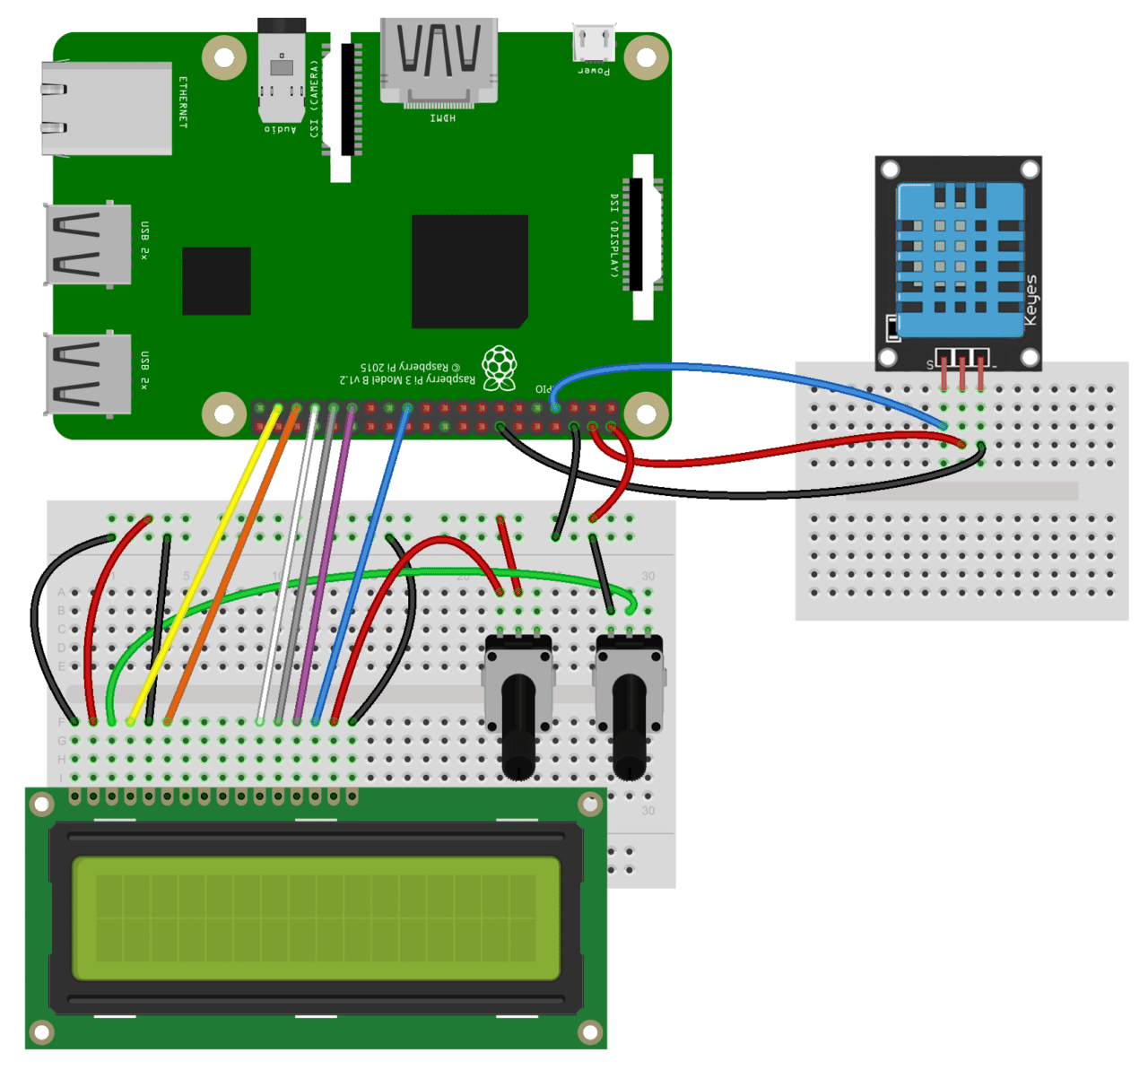
WIRING FOR LCD OUTPUT

Slide 7
PROGRAMMING THE DHT11 WITH PYTHON
We’ll be using the Adafruit DHT11 Python library. You can download the library using Git, so if you
don’t have Git installed on your Pi already, enter this at the command prompt:
sudo apt-get install git-core
To install the Adafruit DHT11 library:
1. Enter this at the command prompt to download the library:
git clone https://github.com/adafruit/Adafruit_Python_DHT.git
2. Change directories with:
cd Adafruit_Python_DHT
3. Now enter this:
sudo apt-get install build-essential python-dev
4. Then install the library with:
sudo python setup.py install

Slide 8
OUTPUT TO AN LCD
To output the DHT11 readings to an LCD, we’ll need to install another Python library called RPLCD to drive the LCD. To install the RPLCD library, we first need to install the Python Package Index, or PIP. PIP might already be installed on your Pi, but if not, enter this at the command prompt to install it:
sudo apt-get install python-pip
After you get PIP installed, install the RPLCD library by entering:
sudo pip install RPLCD
Then we will write the code in linux terminal for showing the output to the LCD

Slide 9
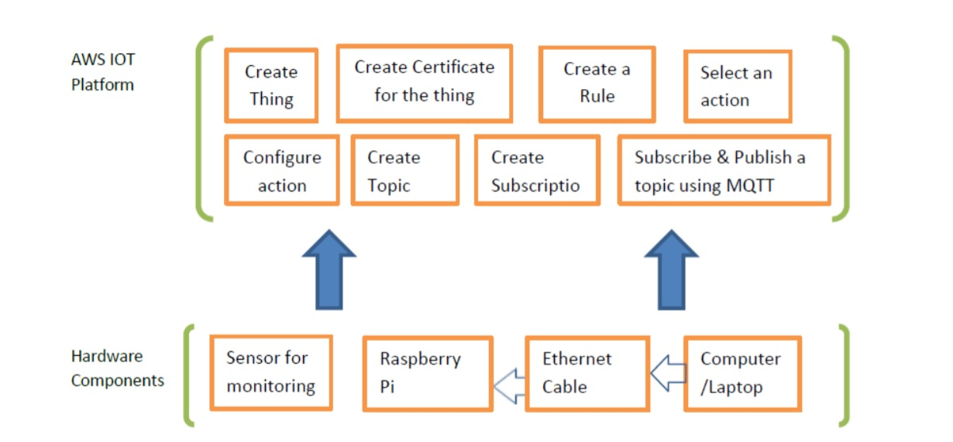
AWS IOT platform

Slide 10
Contd..
The AWS IOT platform act like a cloud server for exchanging the information in between end user and system. A thing is created on AWS cloud server for establishing communication in between Raspberry Pi and server. For authentication purpose a certificate has to be created for that thing. Depending on the requirement a rule is created to evaluate messages sent by the thing and specify what to do when a message is received. An action is selected and configured for sending notifications towards a client related to messages. For publishing messages a topic has to be created. Subscription is created for a topic in which communication protocol as well as end point of the respective client is defined. After creating the subscription, messages can be easily sent towards a particular client. By using MQTT broker a topic can be subscribed as well as published for sending different messages.

Slide 11
Contd..
The Raspberry Pi is connected with AWS IOT platform for remote monitoring of any industrial as well as commercial application. Connections with remote locations can easily achieved by using messaging protocol such as MQTT (Message Queue Telemetry Transport). The publish-subscribe pattern requires a message broker. The broker is responsible for distributing messages to interested clients based on the topic of a message.

Slide 12
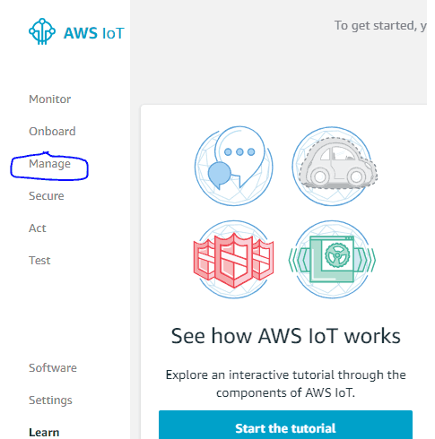
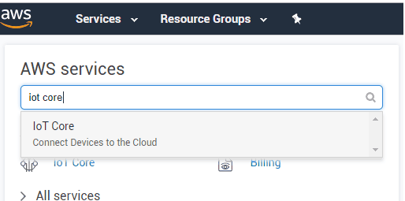
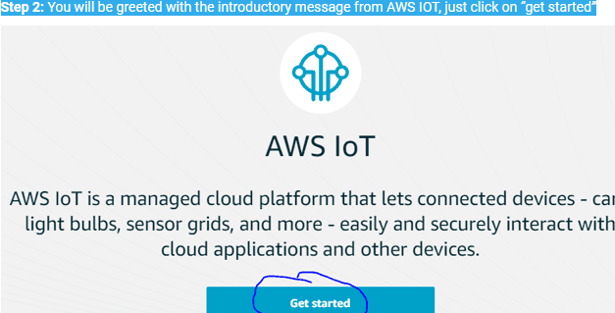
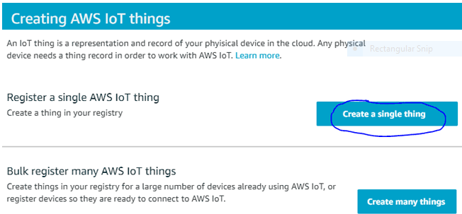
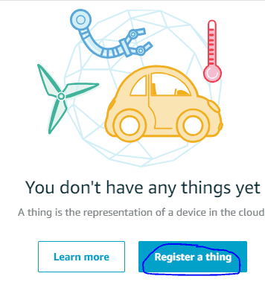
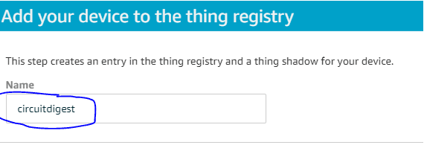
Create a thing in AWS cloud server

Slide 13
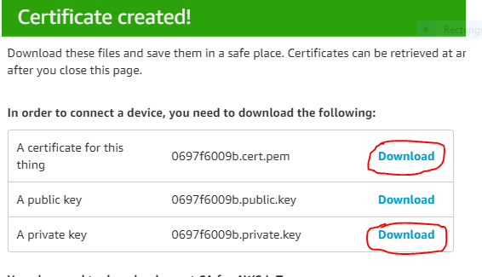
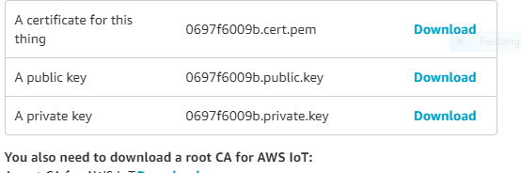
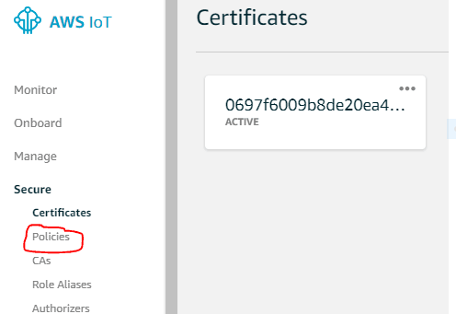
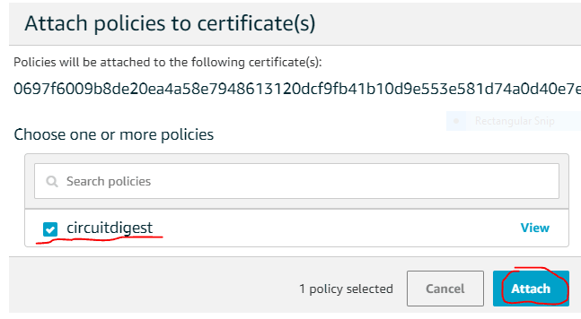
Create a thing in AWS cloud server(continued)

Slide 14
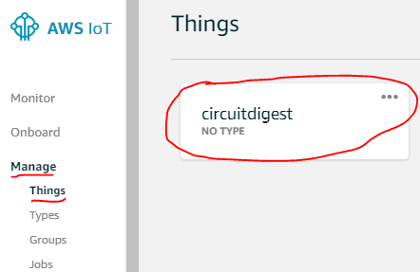
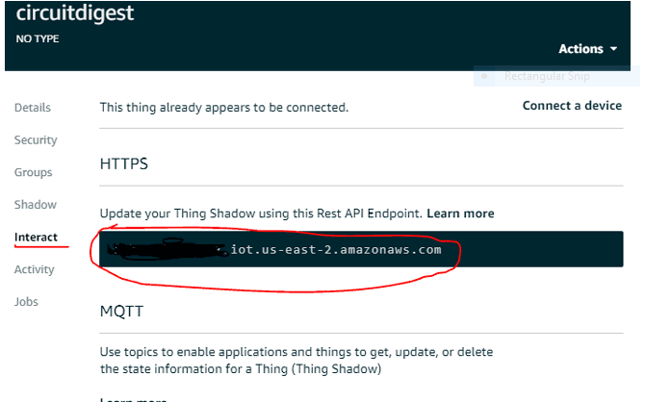
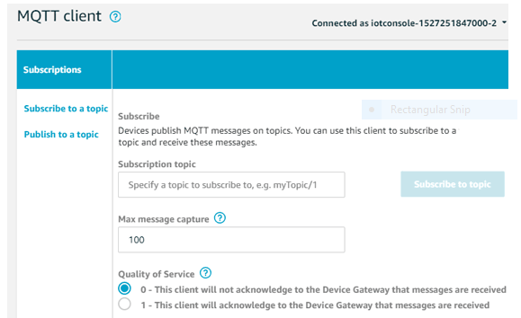
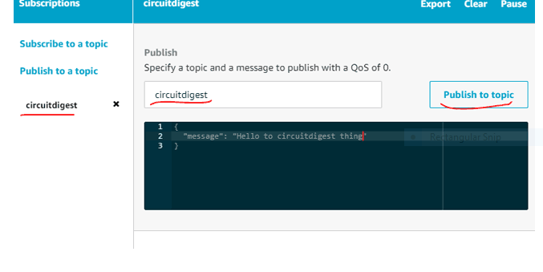
Getting your AWS thing Details: Testing the Thing using the AWS

Slide 15
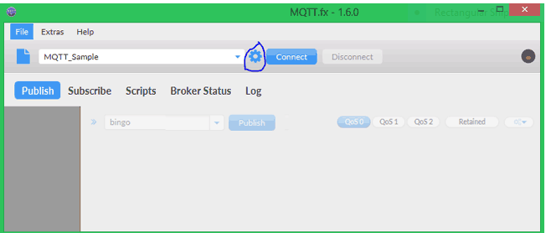
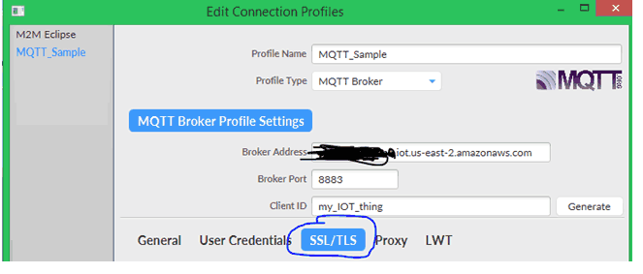

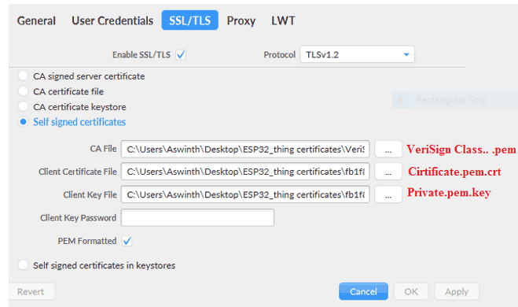
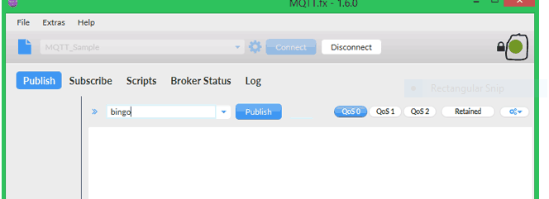
Using MQTT.fx with AWS IOT:

Slide 16
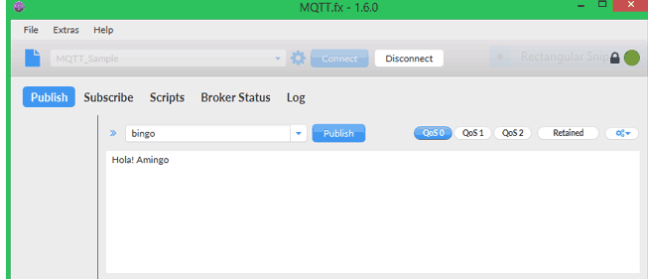
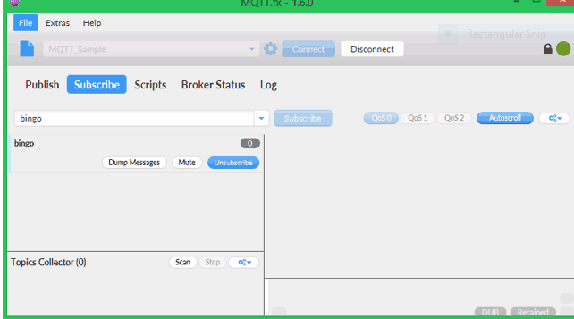
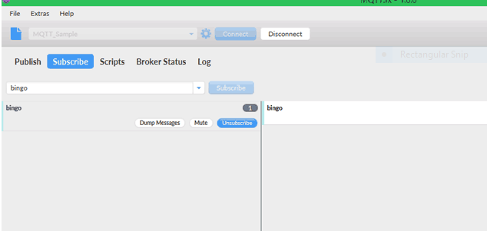
Using MQTT.fx with AWS IOT:

Slide 18
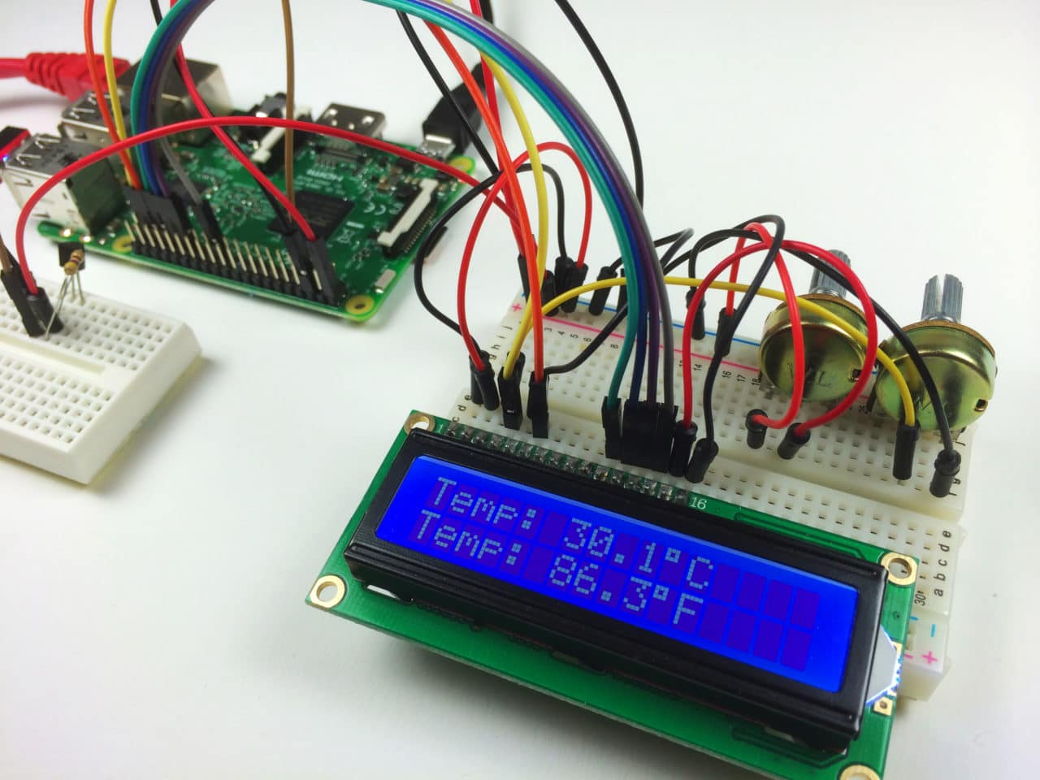
Our desired project…

Slide 19
Reference
http://www.circuitbasics.com/raspberry-pi-lcd-set-up-and-programming-in-python
Byung Ha Kang and Hyun Jin Lee, A Review of Recent Research on Automotive HVAC Systems for EVs- Int. J. Air-Cond. Ref. 25, 1730003 (2017)
https://cdn-learn.adafruit.com/downloads/pdf/dht.pdf
https://circuitdigest.com/tutorial/getting-started-with-amazon-aws-for-iot-projects

